Slide 1
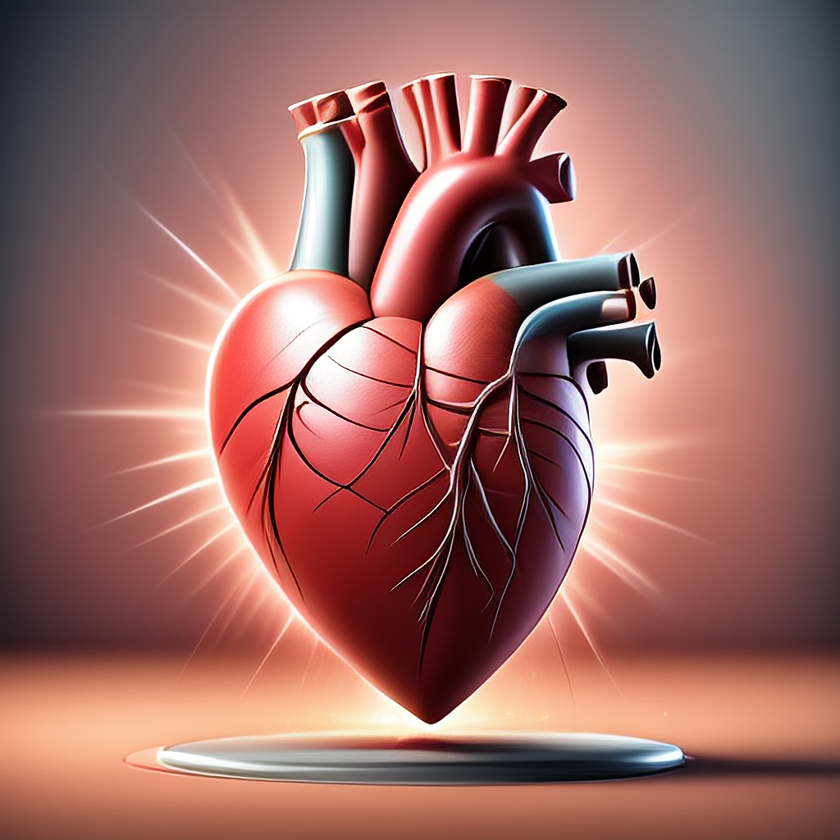
Cardiovascular Health 心血管健康讲座
Jian Shan, MD, FACC

Slide 2
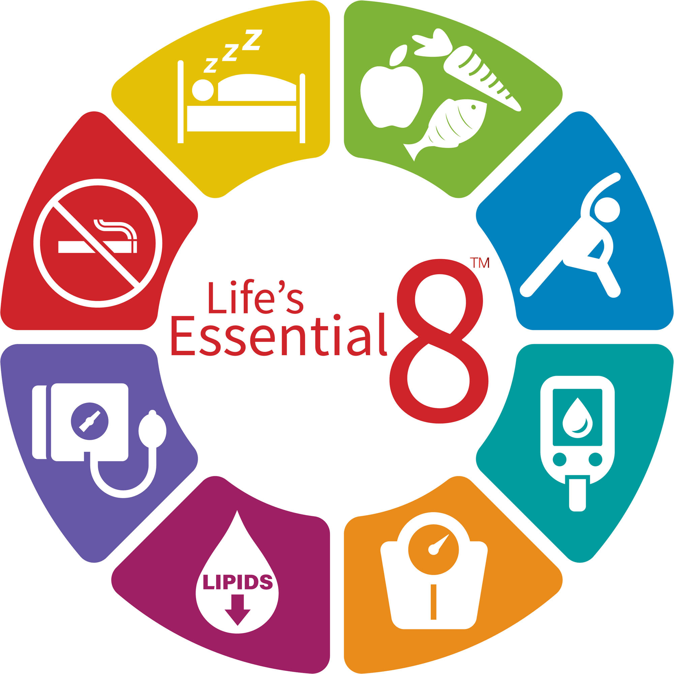
健康生活8要素
© 2022 American Heart Association, Inc.
Donald M. Lloyd-Jones. Circulation. Life’s Essential 8: Updating and Enhancing the American Heart Association’s Construct of Cardiovascular Health: A Presidential Advisory From the American Heart Association, Volume: 146, Issue: 5, Pages: e18-e43, DOI: (10.1161/CIR.0000000000001078)

Slide 3
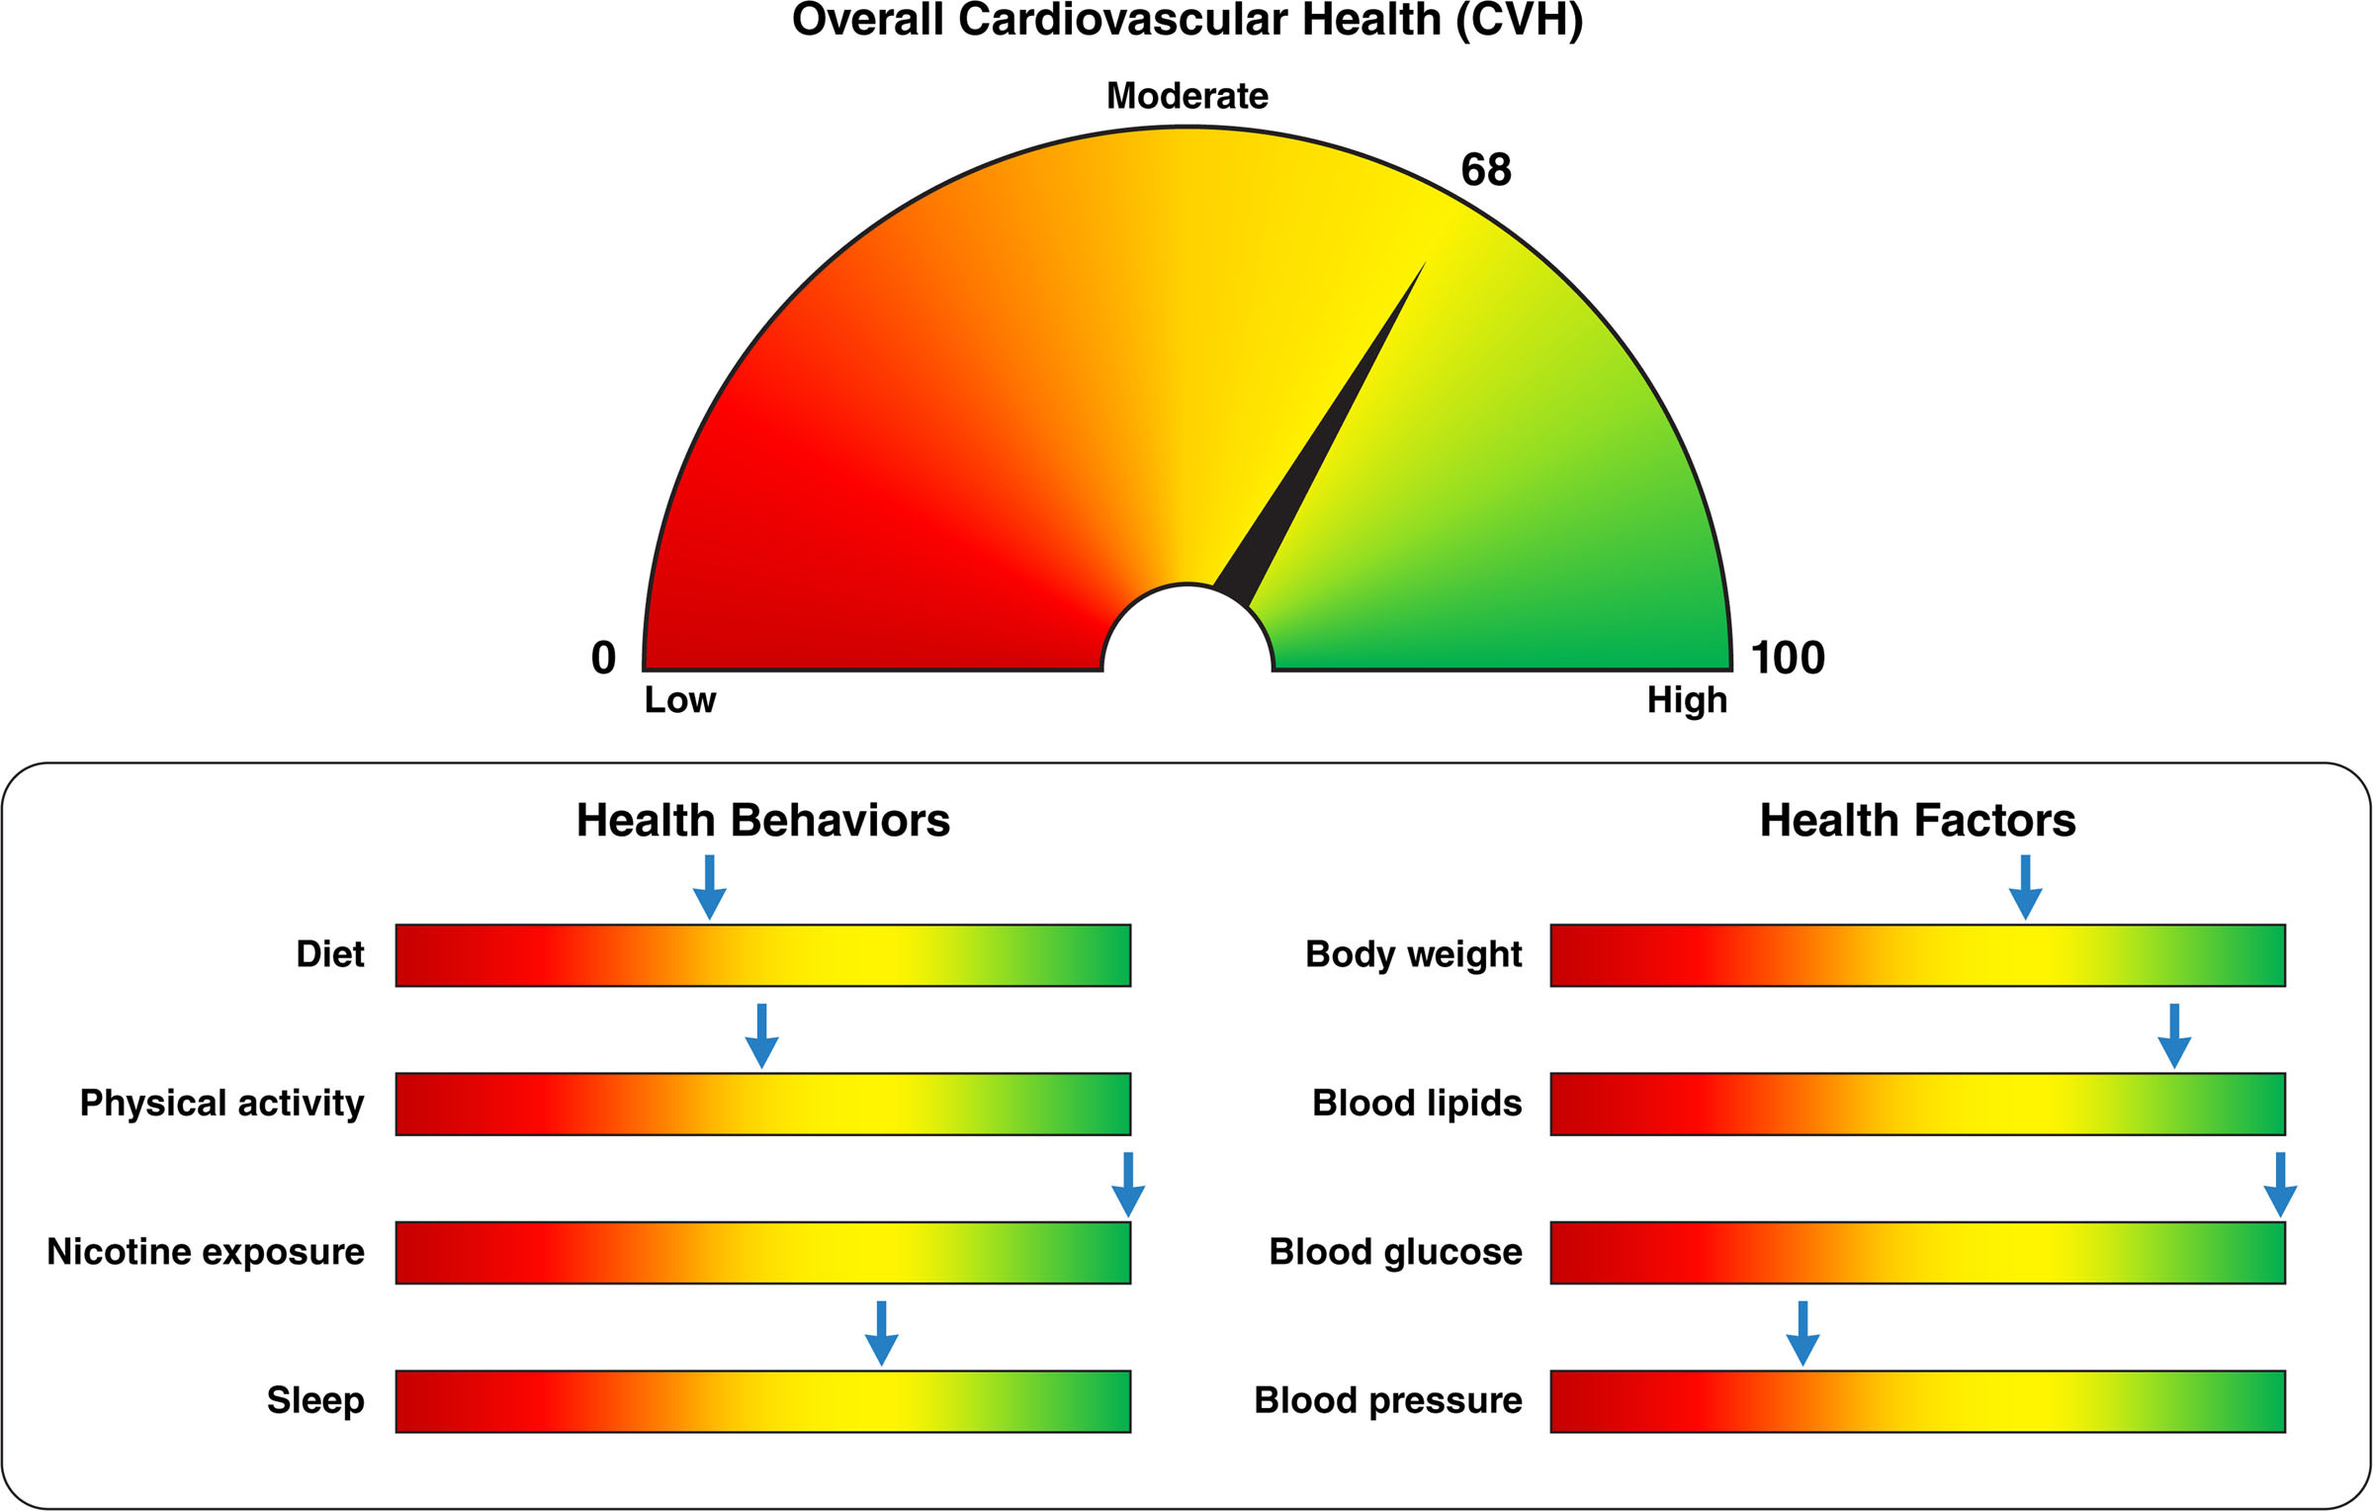
Donald M. Lloyd-Jones. Circulation. Life’s Essential 8: Updating and Enhancing the American Heart Association’s Construct of Cardiovascular Health: A Presidential Advisory From the American Heart Association, Volume: 146, Issue: 5, Pages: e18-e43, DOI: (10.1161/CIR.0000000000001078)
© 2022 American Heart Association, Inc.

Slide 4
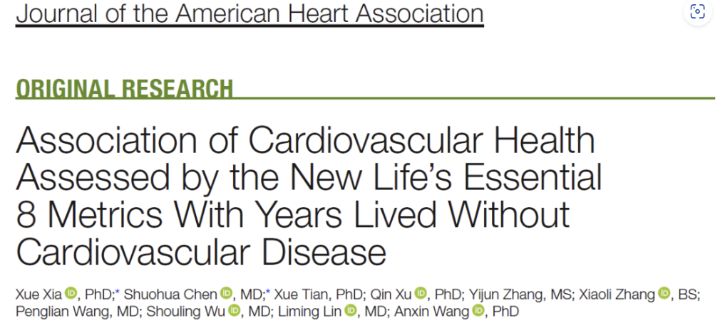
研究纳入89755例基线无心血管疾病的成人受试者。研究人员使用LE8心血管健康评分对每位受试者进行评分后分类，具体分为：
心血管健康程度低（0~49分）
心血管健康程度中等（50~79分）
心血管健康程度高（80~100分）
研究人员纪录从基线（2006年6月~2007年10月）至2020年12月随访期间所发生的心血管疾病事件，并使用生存模型估算不同分类受试者在30~80岁时健康寿命情况。
研究期间共纪录了9977例心血管疾病事件，包括中风6031例和心脏病4577例。LE8心血管健康评分与健康寿命之间存在梯度关系。
J Am Heart Assoc. 2023 Jun 6;12(11)

Slide 5
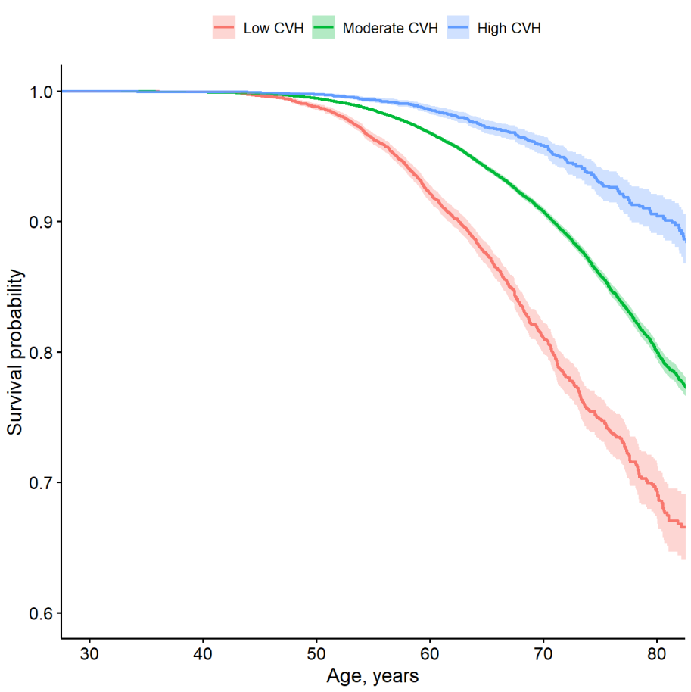
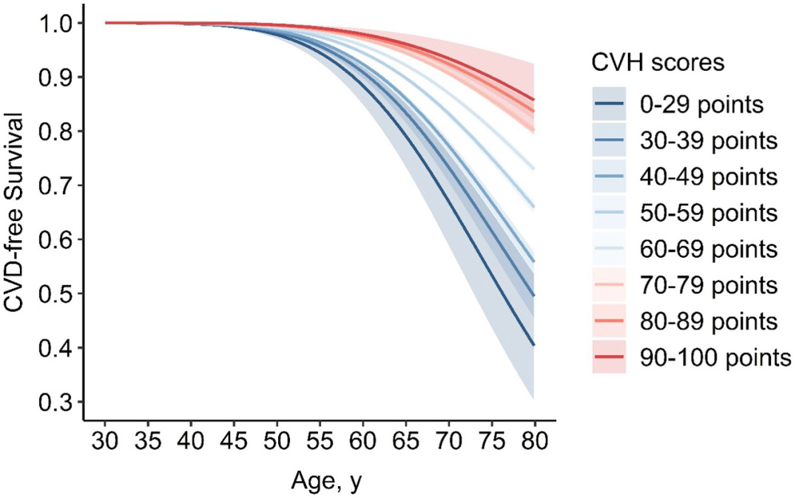
J Am Heart Assoc. 2023 Jun 6;12(11)

Slide 6
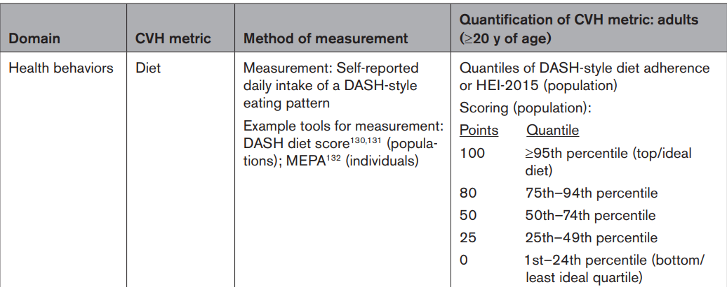
Diet 饮食

Slide 7
DASH diet score
Diet component | 0 | 0.5 | 1
Total grains (servings/day) | ≤5 | >5 to 6.5 | >6.5
Vegetables (servings/day) | ≤2 | >2 to 3.5 | >3.5
Fruits (servings/day) | ≤2 | >2 to 3.5 | >3.5
Dairy (servings/day) | ≤1 | >1 to 2 | >2
Meat, poultry, and fish (servings/day) | >3.5 | >2 to 3.5 | ≤2
Nuts, seeds, and dry beans (servings/week) | ≤2 | >2 to 3.5 | >3.5
% kcal from fat | >29.5 | >27.5 to 29.5 | ≤27.5
% kcal from saturated fat | >7.5 | >6 to 7.5 | ≤6
Sweets (servings/week) | >7 | >5.5 to 7 | ≤5.5
Sodium (mg/day) | >3,000 | >2,400 to 3,000 | ≤2,400
From 0-10

Slide 8
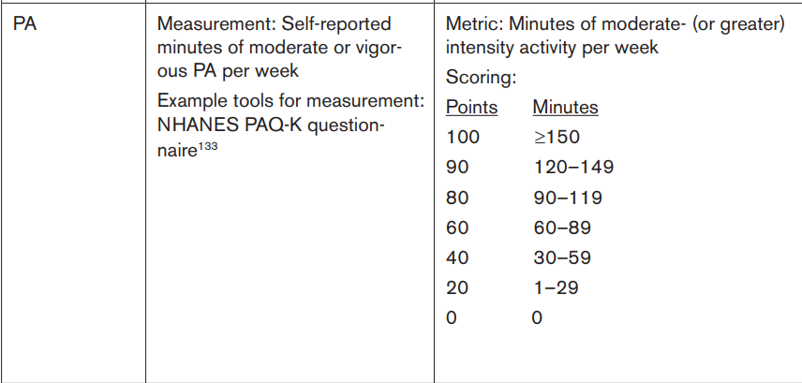
Physical activity 运动

Slide 9
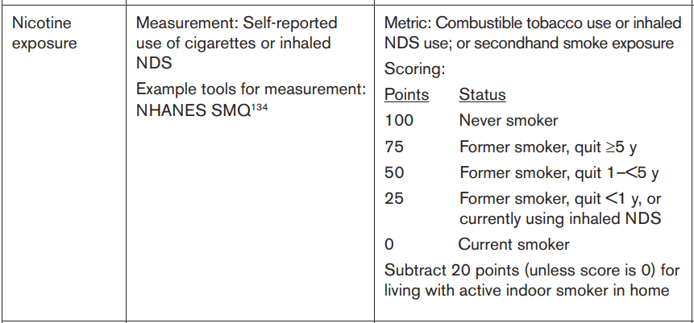
Nicotine exposure 吸烟

Slide 10
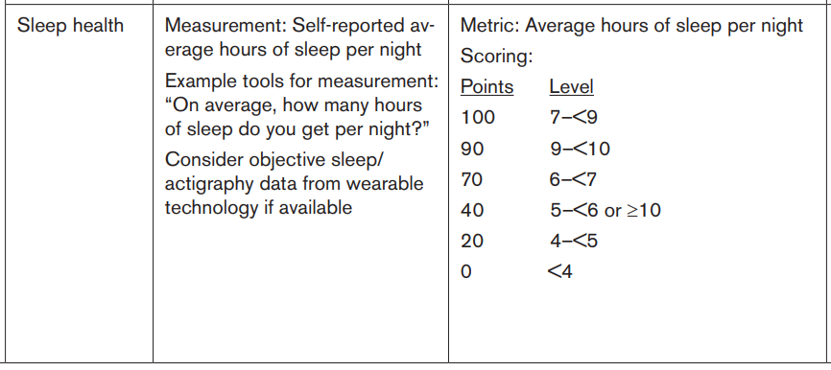
Sleep 睡眠

Slide 11
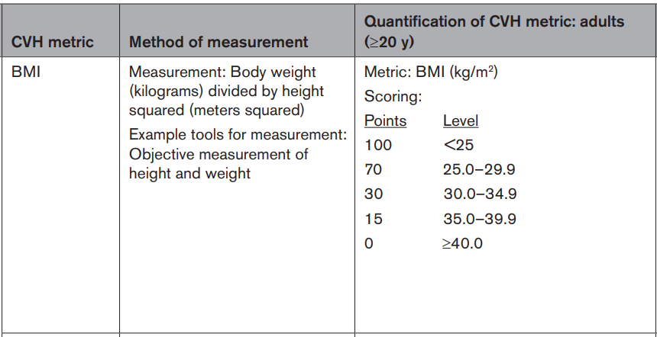
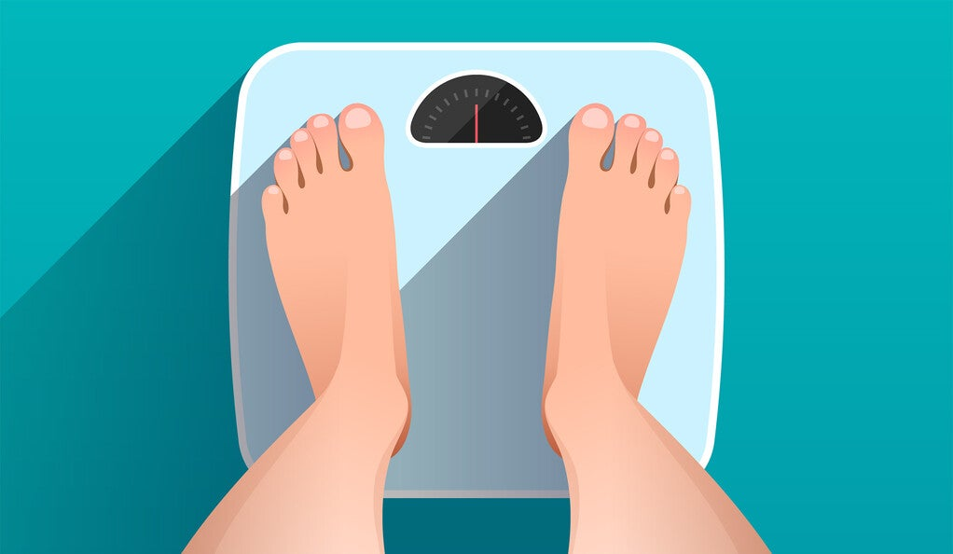
Body weight 体重

Slide 12
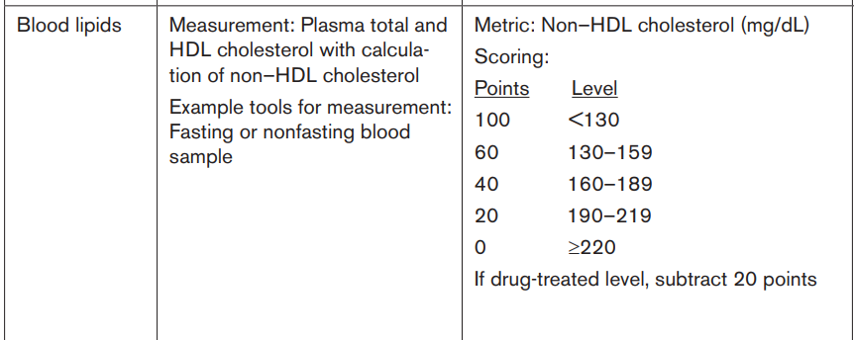
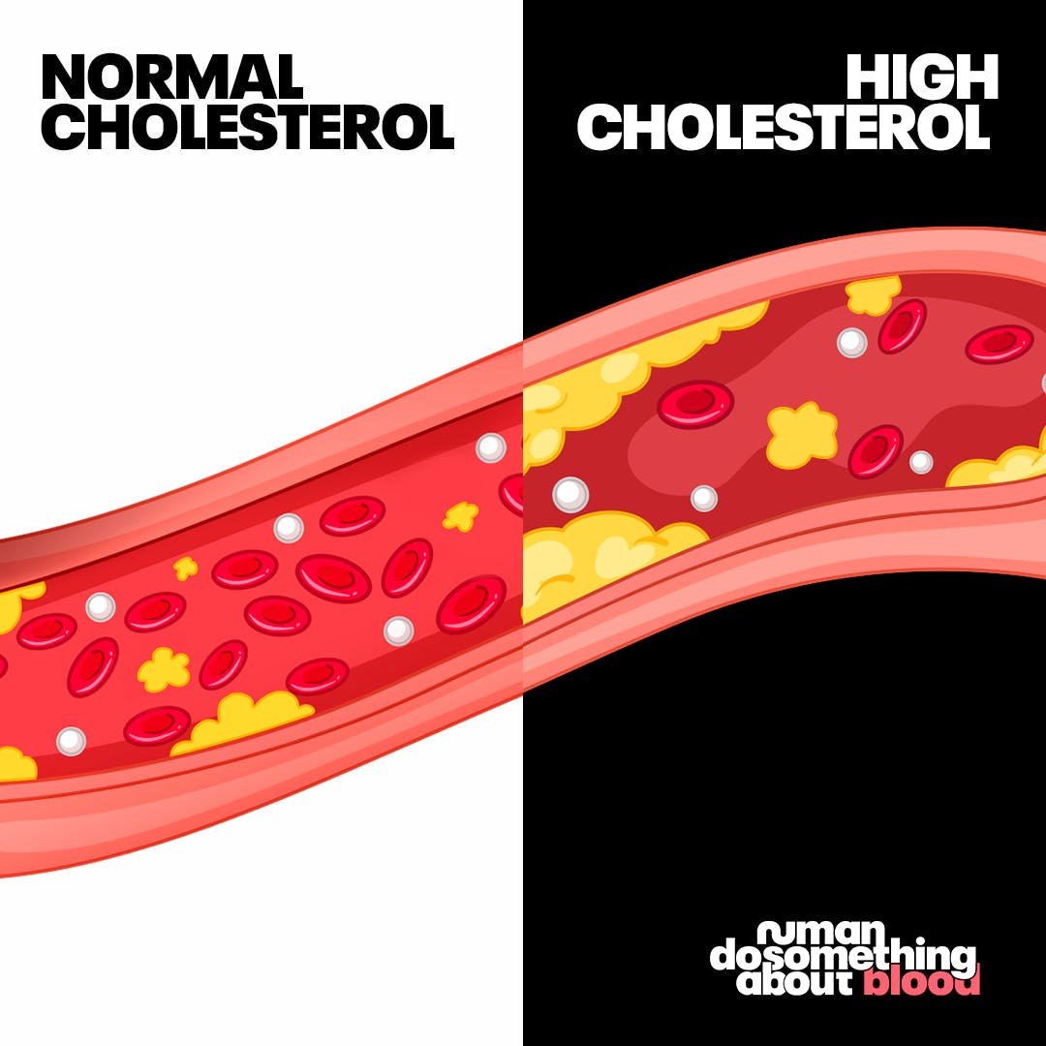
Cholesterol 血脂

Slide 13
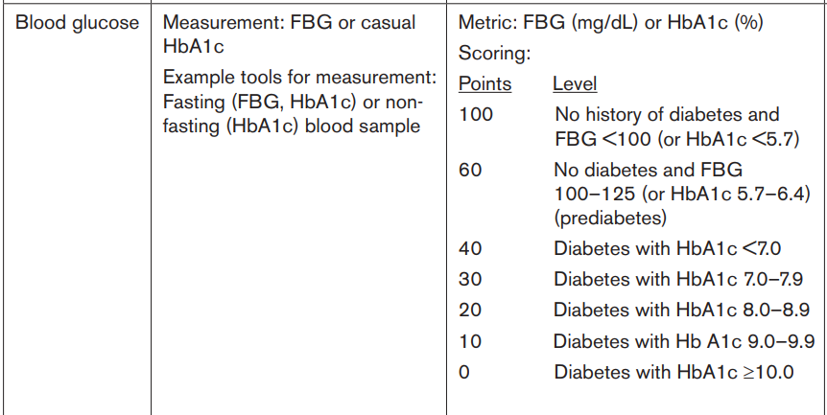
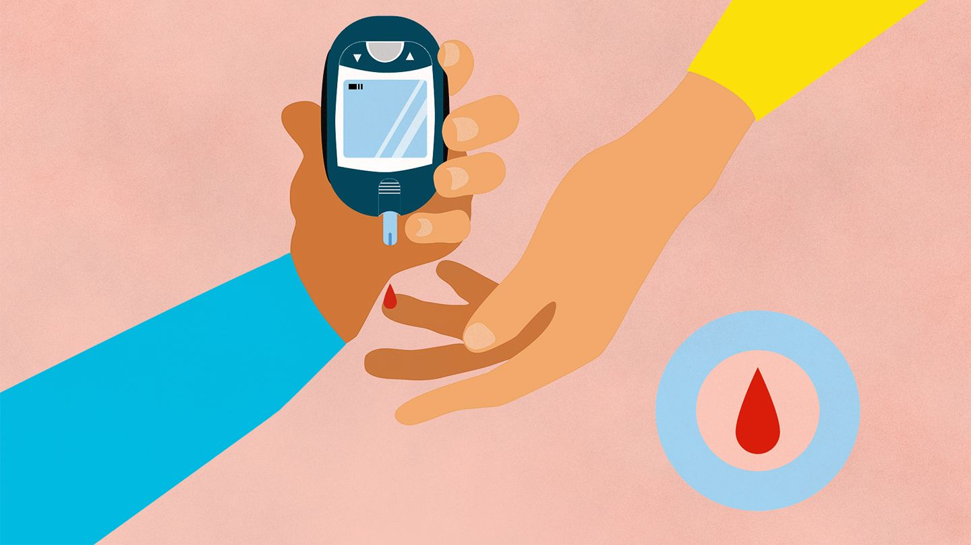
Blood glucose 血糖

Slide 14
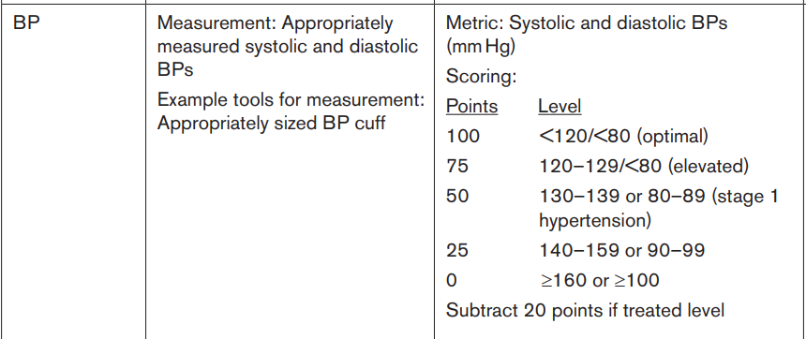
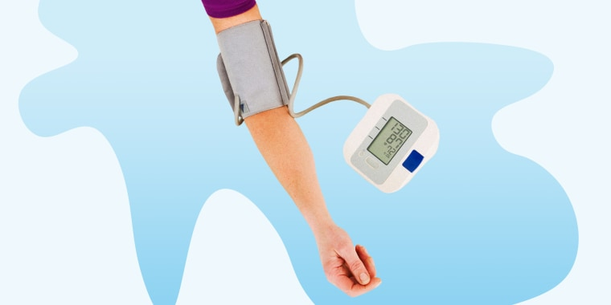
Blood pressure 血压

Slide 15
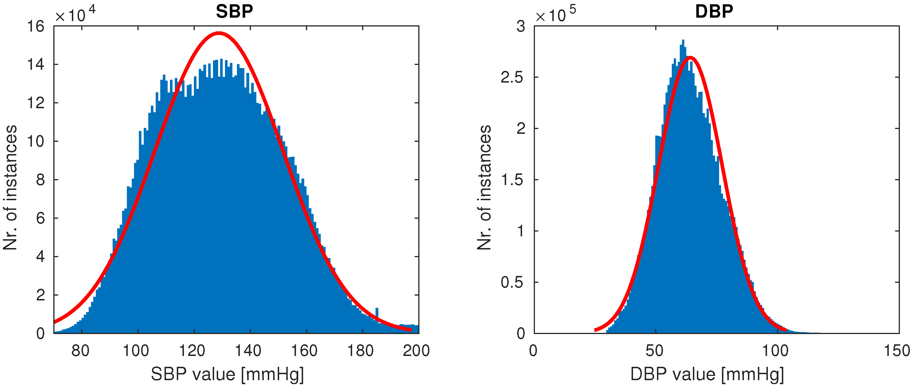
BP control 血压控制
BP distribution in general population 正常人群血压数值分布
Sensors 2019, 19(15), 3420

Slide 16
How to measure BP 如何正确测量血压？
2020 International Society of Hypertension Global Hypertension Practice Guidelines

Slide 17
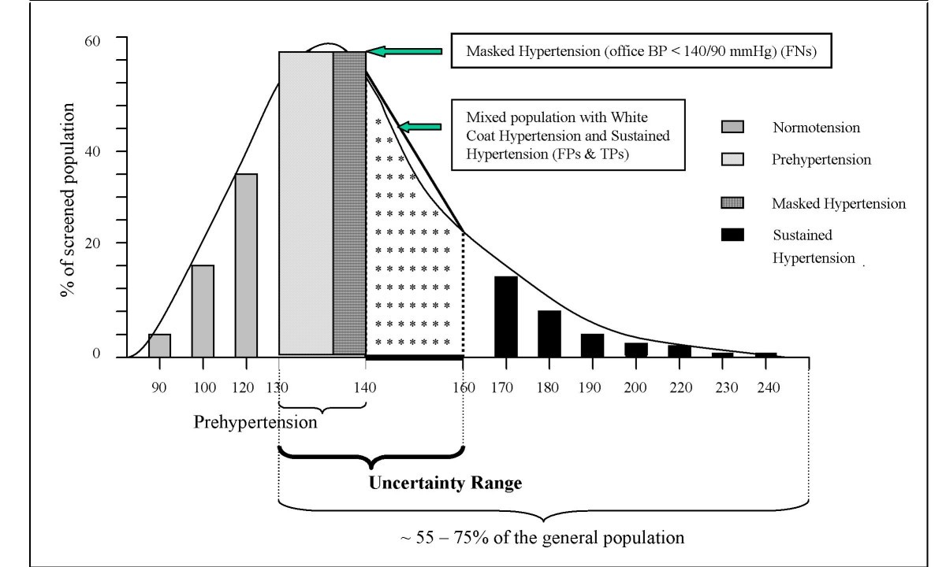
BP control 血压控制
Current Controlled Trials in Cardiovascular Medicine volume 6, Article number: 5 (2005)

Slide 18
Hypertension Complications 高血压并发症
中风
视力减退
心力衰竭
心肌梗塞
肾衰竭
性功能障碍

Slide 19
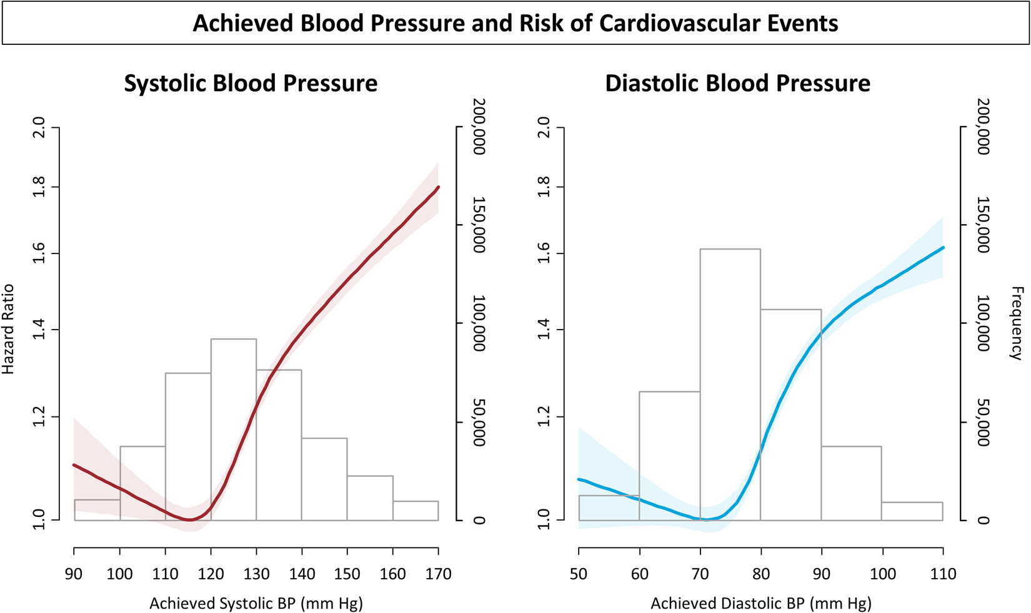
What is the BP target? 目标血压？
收缩压
舒张压

Slide 20
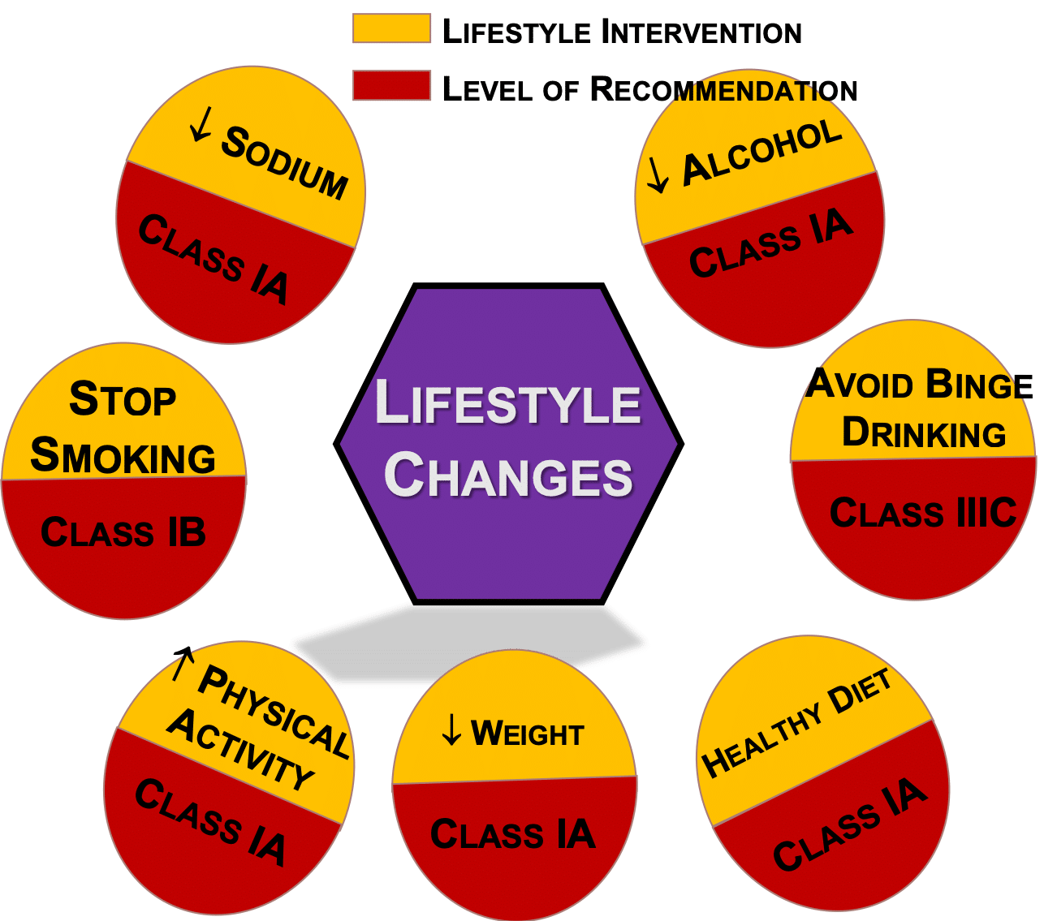
How to treat hypertension? 高血压治疗
Diet 饮食
Exercise 运动
Medications 药物

Slide 22
Lower BP 9-15 mmHg

Slide 23
Physical activity 运动
Exercise 150 min/week lower BP 6-9 mmHg

Slide 24
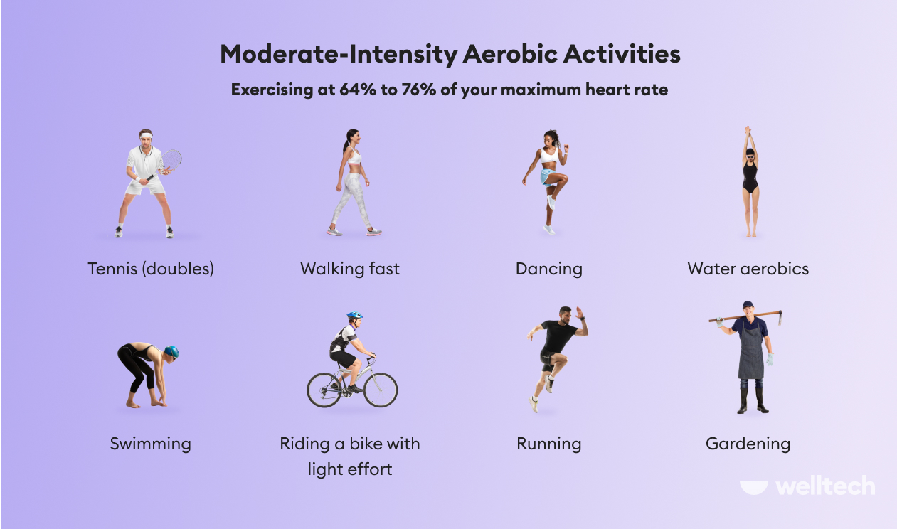

Slide 25
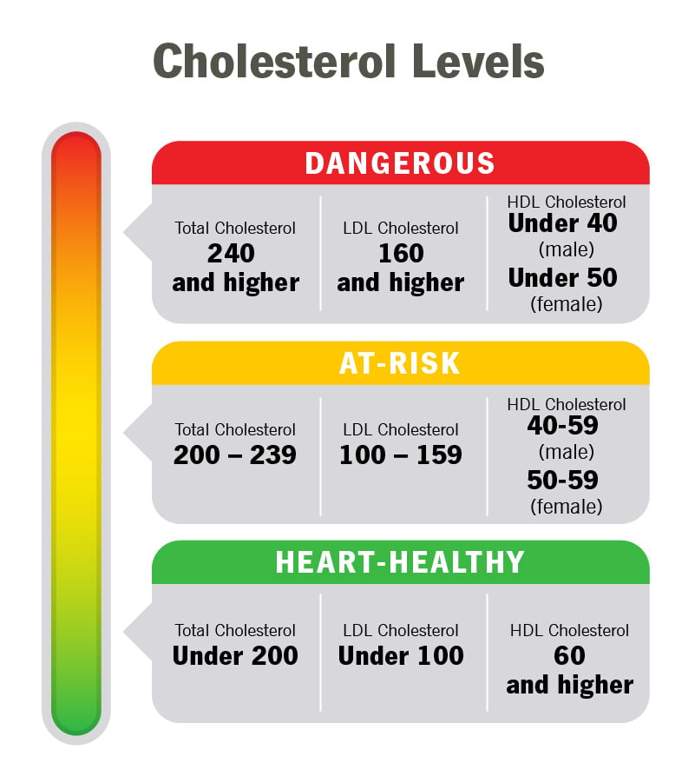
Lipid Control 血脂控制
HDL – Good cholesterol
高密度脂蛋白 – 好胆固醇
LDL – Bad cholesterol
低密度脂蛋白 – 坏胆固醇

Slide 26
Lipid profile 血脂化验

Slide 27
动脉粥样硬化发展时间线

Slide 28
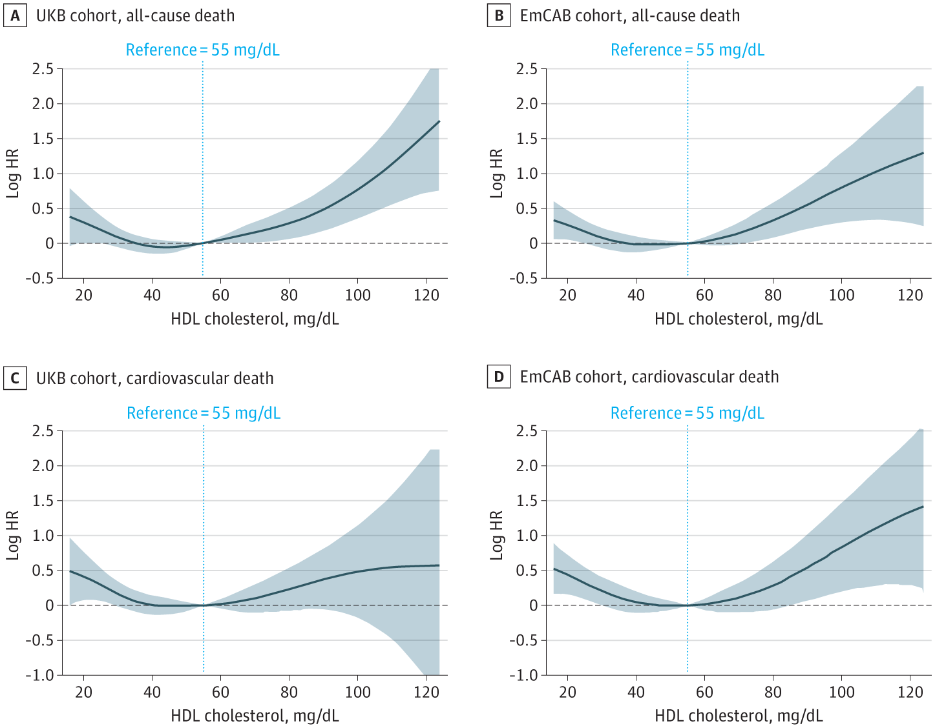
JAMA Cardiol. 2022;7(7):672-680.

Slide 29
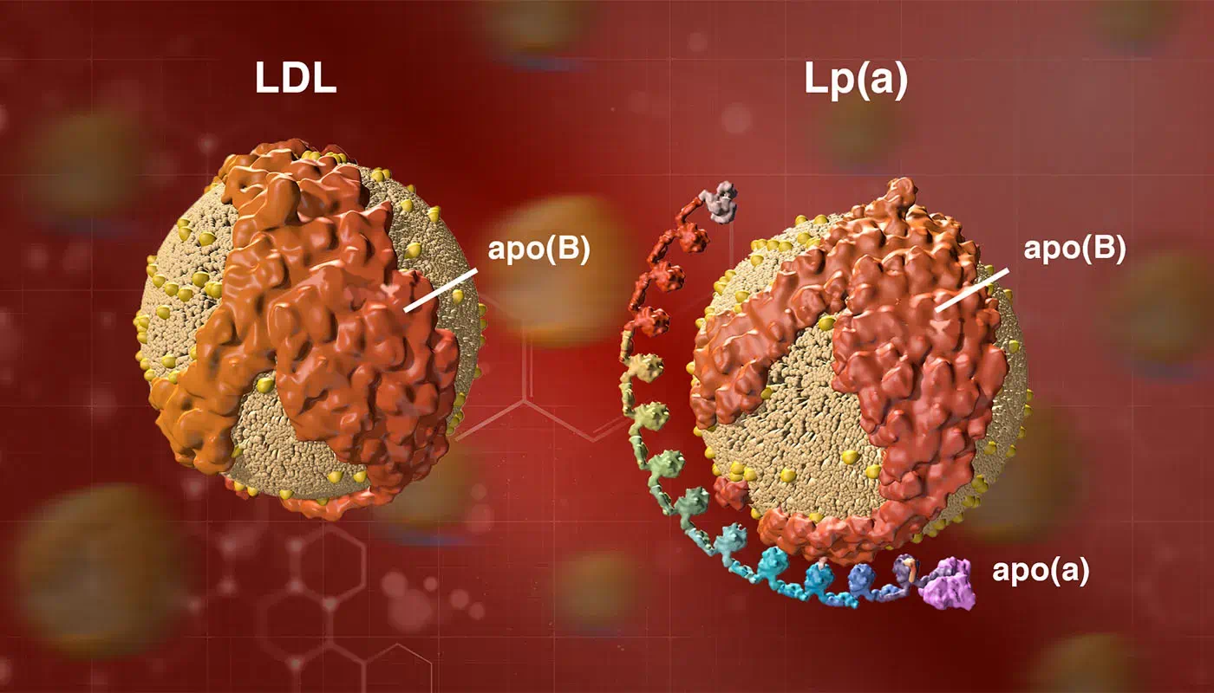
Lipoprotein (a)

Slide 30
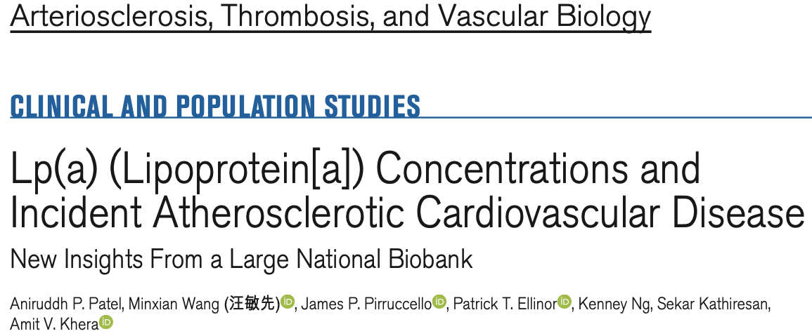
Arterioscler Thromb Vasc Biol. 2021;41:465–474

Slide 31
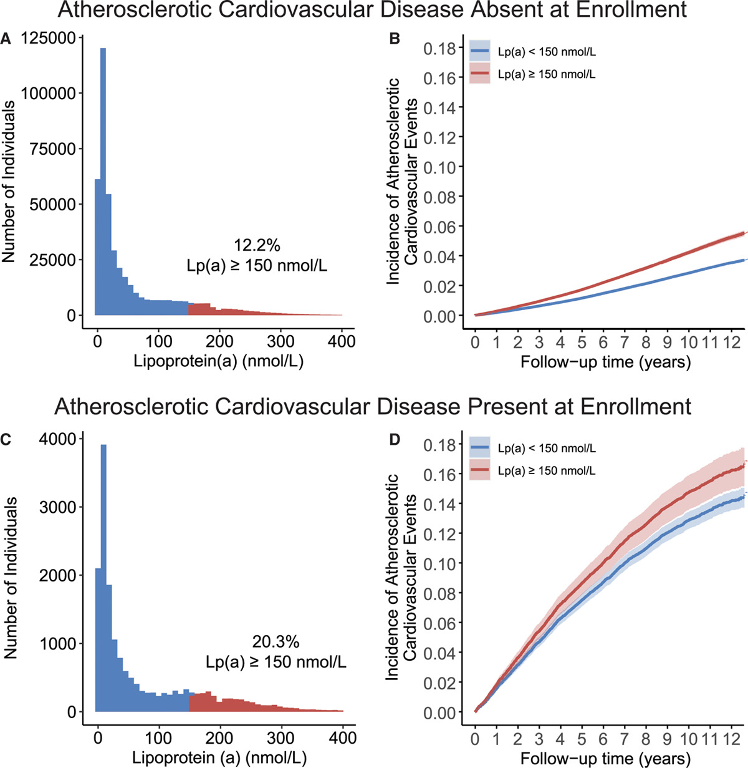
If Lp(a) is very high, > 200, we normally start treatment immediately
Arterioscler Thromb Vasc Biol. 2021;41:465–474

Slide 32
Lipid Control 血脂控制
Lifestyle modification 改变生活方式
Diet – low cholesterol diet 低脂饮食
Regular exercise 150 min/week. 运动
Unfortunately, unlikely BP control, lifestyle modification only contributes to 25-35% of LDL level.
It does increase HDL level. 确实可以提升HDL水平
Medications 药物治疗
Surgical control – Bariatric surgery

Slide 33
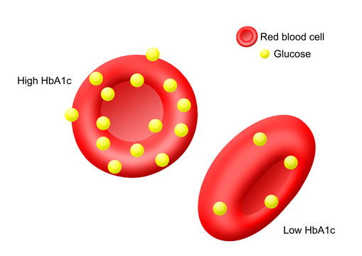
Glucose Control 血糖控制
HbA1c Represents average glucose level in the past 3 months
糖化血红蛋白代表前3个月平均血糖水平

Slide 34
Glucose Control 血糖控制

Slide 35
Glucose Control 血糖控制
Lifestyle modification 改变生活方式
Diet – low cholesterol diet
Regular exercise 150 min/week.
Medications 药物
Surgical control – Bariatric surgery

Slide 36
New Glucose Control Agents 血糖控制新药 SGLT2 inhibitors

Slide 37
New Glucose Control Agents 血糖控制新药 GLP-1 agonist

